Slide 1
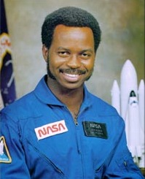
Ronald McNair
Notes:
# Name Ronald McNair # Textbook Knight, Physics for Scientists and Engineers: A Strategic Approach with Modern Physics, 3rd Edition, chapter 6, section 6 # Description McNair was an American physicist and an astronaut for NASA. He only lived until the age of 36, for he died during the launch of the Space Shuttle Challenger in 1986. He received his bachelors from North Carolina A & T State, and received doctorates from MIT, NC A&T State, Morris College and Univ. or South Carolina. McNair was a 5th degree black belt in karate and a performing Jazz saxophonist. # Sources Biographical Data of Ronald E. McNair. (2003, December). Retrieved February 20, 2018, from https://www.jsc.nasa.gov/Bios/htmlbios/mcnair.html # Photo https://upload.wikimedia.org/wikipedia/commons/a/a1/Ronald_mcnair.jpg

